Slide 1
Lecture 3
Data linearization

Slide 2
Introduction
In previous lectures we learned how we can fit a linear model to a data set
Often nonlinear models need to be fitted
In the coming lectures on machine learning we will see some algorithms able to handle nonlinear models
In the present lecture we discuss some cases were a nonlinear model can be linearized
Notes:
In previous lectures we learned how we can fit a linear model to a data set
We did this by searching for the model parameters that minimizes the squared error.
This did lead us to a formula for the parameters ao and a1
However, often data can not be represented by linear models.
In the next lesson on machine learning we will see some algorithms able to handle none linear models.
For the moment we are going to discuss some cases where, even the model is nonlinear, it can still be solved using the approach we developed for the linear model.

Slide 3
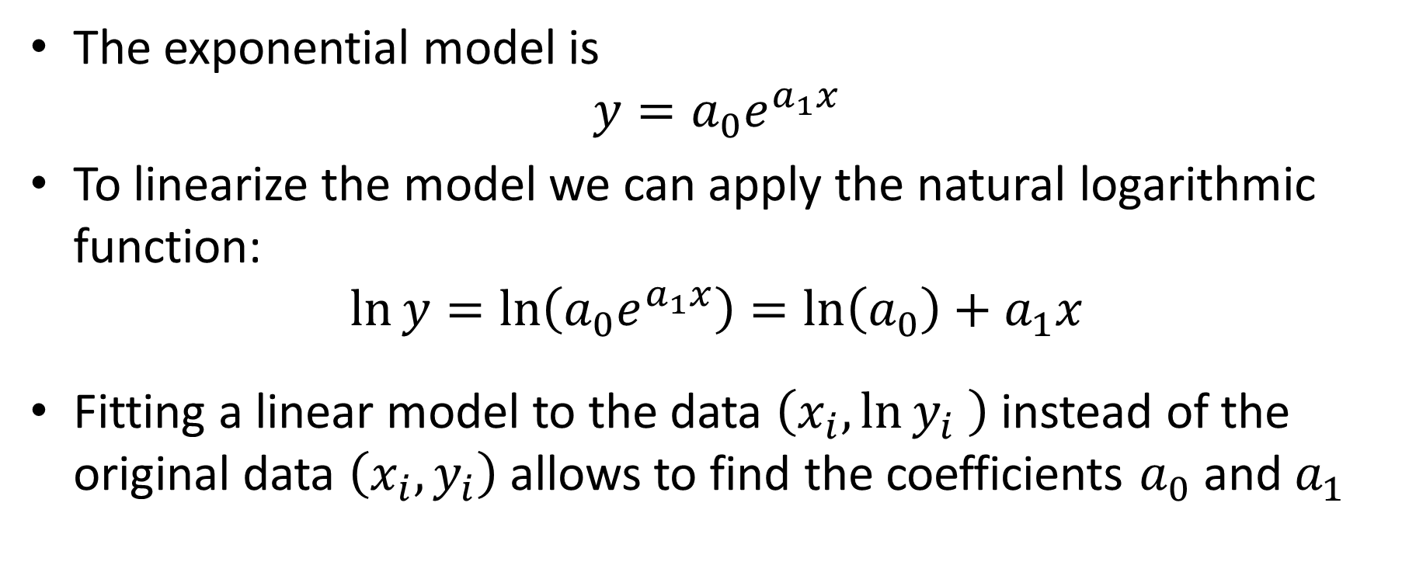
Exponential model
The exponential model is
$$y=a_{0}e^{a_{1}x}$$
To linearize the model we can apply the natural logarithmic function:
$$\ln{y}=\ln\left(a_{0}e^{a_{1}x}\right)=\ln\left(a_{0}\right)+a_{1}x$$
Fitting a linear model to the data $\left(x_{i},\ln{y_{i}} \right)$ instead of the original data $\left(x_{i},y_{i}\right)$ allows to find the coefficients $a_{0}$ and $a_{1}$
Notes:
The first nonlinear model we discuss is the exponential model
It has two parameters ao and a1 and writes as y = ao times e to the power of a1 times x
This expression is nonlinear but with a simple trick we can linearize it
Apply the natural logarithm to both side. What do we obtain?
A linear relation between ln(y) and x
We can conclude that is we fit a linear model to the data points xi, ln(yi), instead of (xi, yi), we can find our two model parameters.
In a general sense, any mathematical operation applied to the data set to transform a nonlinear relation into a linear relation is called data linearization

Slide 4
Example – Number of transistors in a CPU
CPU | Year | Transistors
4004 | 1971 | 2250
8008 | 1972 | 2500
8080 | 1974 | 5000
8086 | 1978 | 29000
286 | 1982 | 120000
386 | 1985 | 275000
486 | 1989 | 1180000
Pentium | 1993 | 3100000
Pentium II | 1997 | 7500000
Pentium III | 1999 | 24000000
Pentium 4 | 2000 | 42000000
Itanium | 2002 | 220000000
Itanium 2 | 2003 | 410000000
Notes:
Let us consider an example
The table displays for different CPUs of the company Intel the number of transistors inside the CPU.
Note how the number of transistors increase with the year of release of the CPU model.

Slide 5
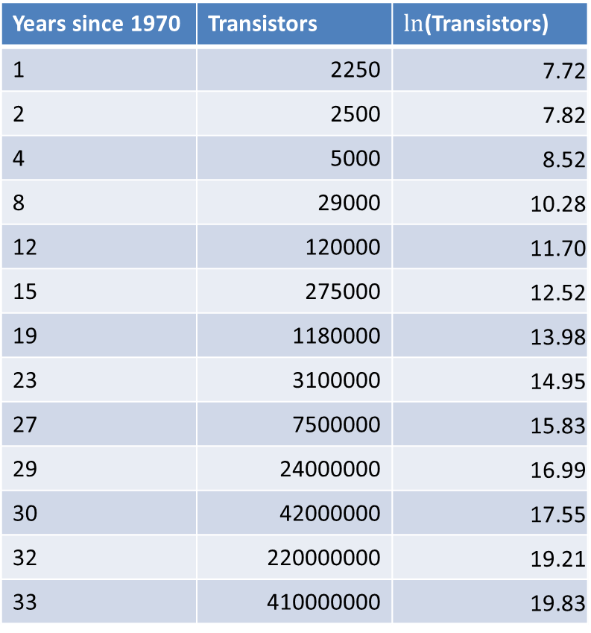



Example – Number of transistors in a CPU
Years since 1970 | Transistors | $ln$(Transistors)
1 | 2250 | 7.72
2 | 2500 | 7.82
4 | 5000 | 8.52
8 | 29000 | 10.28
12 | 120000 | 11.70
15 | 275000 | 12.52
19 | 1180000 | 13.98
23 | 3100000 | 14.95
27 | 7500000 | 15.83
29 | 24000000 | 16.99
30 | 42000000 | 17.55
32 | 220000000 | 19.21
33 | 410000000 | 19.83
Moore’s law
Ln(Transistors)
Years since 1970
$$\ln{\text{(}\text{Transistors}})=7.1969+0.3546x$$
$$\text{Transistors}=1335.3e^{0.3546x}$$
Doubling rate$≅\ln{2}/0.3546≅2$ years
Notes:
Form the values in the table you can easliy guess that the number of transistors does not depend linearly of time.
On the contrary it increases very fast.
However, if we plot the number of transistors in function of the year of release in a semi-log scale then the dependence become liner.
We did this by plotting ln(number of transistors) versus the number of years since 1970
We can now use the formulas we developed in previous lectures to find the model parameters of a liner model adjusting the plotted data
Try it by yourself
You should find the displayed relation
Plotting the relation on our graph confirms that we have a nice fit.
From this linear relation we can compute the dependence of the number of transistors of the number of year since 1970
It is interesting to compute the doubling rate of this exponential growth
The doubling rate is the time required to double the number of transistors
One gets approximatively 2 years
This is known as Moore’s law.
It was first formulated in 1965, and further revised in 1975, by Gordon Moore,, a former CEO of Intel.
Simply apply th exponential function to both sides.

Slide 6
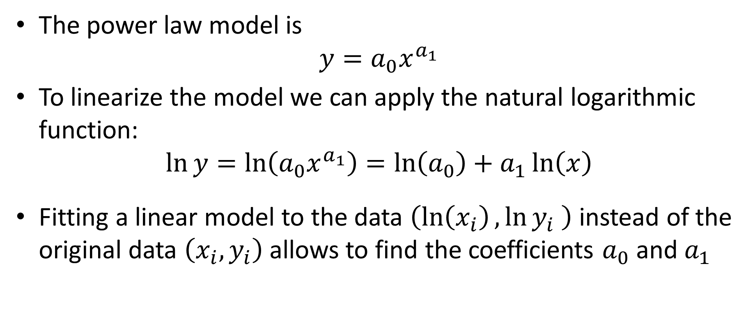
Power law
The power law model is
$$y=a_{0}x^{a_{1}}$$
To linearize the model we can apply the natural logarithmic function:
$$\ln{y}=\ln\left(a_{0}x^{a_{1}}\right)=\ln\left(a_{0}\right)+a_{1}\ln\left(x\right)$$
Fitting a linear model to the data $\left(\ln\left(x_{i}\right),\ln{y_{i}} \right)$ instead of the original data $\left(x_{i},y_{i}\right)$ allows to find the coefficients $a_{0}$ and $a_{1}$
Notes:
We discuss now a second example of nonlinear model that can be linearized: the power law
The power law has two parameters ao and a1 and it writes y = ao times x to the power of a1
Linearization can be achieved by applying a logarithmic function, for example the natural logarithm, on both sides
The relation becomes now linear between ln(y) and ln(x)
Fitting a linear model to the data $\left(\ln\left(x_{i}\right),\ln{y_{i}} \right)$ instead of the original data $\left(x_{i},y_{i}\right)$ allows to find the coefficients $a_{0}$ and $a_{1}$

Slide 7
Example – Human growth
Age (years) | Height H (m) | Weight W (kg)
2 | 0.9120 | 13.7
3 | 0.9860 | 15.9
4 | 1.0600 | 18.5
5 | 1.1300 | 21.3
6 | 1.1900 | 23.5
7 | 1.2600 | 27.2
8 | 1.3200 | 32.7
9 | 1.3800 | 36.0
10 | 1.4100 | 38.6
11 | 1.4900 | 43.7
Weight W (kg)
Height H (m)
Notes:
As an example let us consider some data about the growth of young children
The table lists in function of the age the average height and weight of children
Plotting the data confirms that the relation between height and weight is not linear

Slide 8


Example – Human growth
Ln(H ) | Ln(W)
-0.09212 | 2.617396
-0.0141 | 2.766319
0.058269 | 2.917771
0.122218 | 3.058707
0.173953 | 3.157
0.231112 | 3.303217
0.277632 | 3.487375
0.322083 | 3.583519
0.34359 | 3.653252
0.398776 | 3.777348
Ln(W)
Ln(H)
$$\ln{\text{(}}W)=2.7914+2.4199\ln{H}$$
$$W=16.3H^{2.42}$$
Notes:
However the relation between the logarithm of the height and logarithm of the weight is linear
We can fit a linear model to these modified data
Try it by yourself
You should find the relation displayed
If we want to find the model parameters of the power law, we can simply apply the exponential function on both sides

Slide 9
Summary
Nonlinear models can not be fitted with linear regression
However some models can be linearized
Two examples we discussed are
Exponential model
Power law
The exponential model is suited for data that is linear in a semi-log scale
The power law is suited for data that is linear in a log-log scale
Notes:
Let us summarize the key findings
Nonlinear models can not be fitted with linear regression
However some models can be linearized
Two examples we discussed are
The exponential model
And the Power law
The exponential model is suited for data that is linear in a semi-log scale
The power law is suited for data that is linear in a log-log scale

